Slide 1
MCF and the SDM4 MCF MSA
Gabe Sudduth
MCF Solutions Program Manager
Corning Incorporated
August 20, 2026

Slide 2
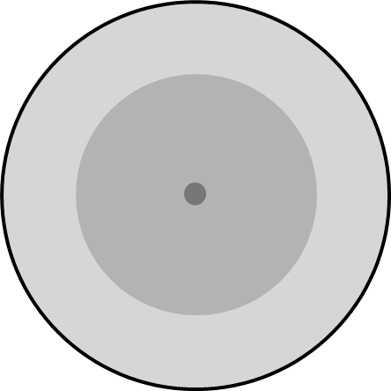
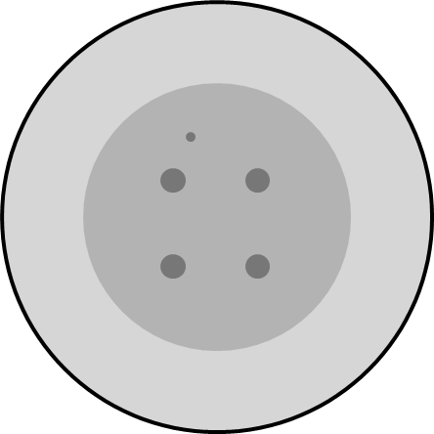
Multicore Fiber (MCF) – a new paradigm in optical fiber that will enable a step change in density
What is MCF?
Single-core fiber
A step change in density (4x) using MCF
4x transmission capacity per fiber without increasing size or weight
Optical performance like today’s standard single-mode fibers
Negligible crosstalk between cores
Marker core
Cladding
125µm
Coating
190µm
Core pitch
40µm
MCF delivers unmatched transmission capacity and fiber density, enabling compact, high-throughput connectivity for next generation networks
Notes:
More connections require next-generation solutions
Multicore fibers (MCF), with >1 light-transmitting cores encased in common cladding, have a significantly higher transmission capacity than traditional single-core fiber. As the number of cores increases, so does the capacity (and density) achievable with MCF
As much as 4x capacity per fiber (cores/mm²), without increasing cable volume
Optical performance like today’s standard single-mode fibers
Negligible crosstalk

Slide 3
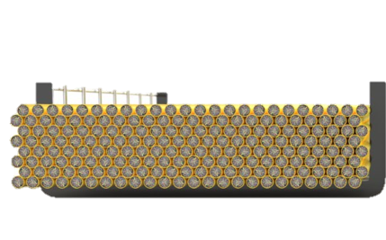

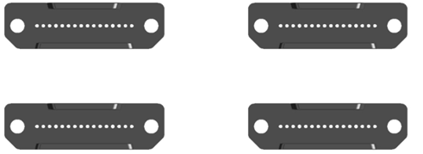
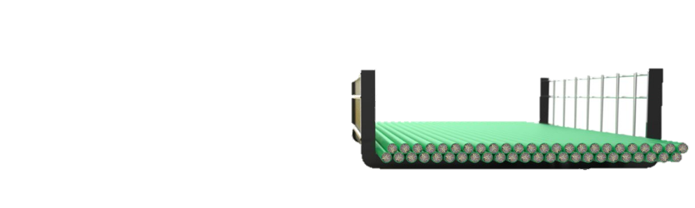
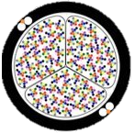
Inside the data center MCF enables scalable, high-density solutions with significant material reduction & deployment efficiency
What need does MCF address?
Density Deployment Efficiency Sustainability
Up to 70% less cable mass
Ease civil engineering requirements
Up to 75% fewer connections
Can reduce installation time by up to 60%
Less material
Enhance supply chain resilience and environmental sustainability
3456 Fibers
864 MCF Fibers
Notes:
Maximize Density
70% reduction in cable weight
73% reduction cable cross-sectional cable area
Deployment efficiency
→ reduced labor cost and deployment time
→ faster time to revenue
→ boost supply assurance
Enhanced scalability
→ data capacity
→ infrastructure efficiency
→ energy and cost efficiency

Slide 4
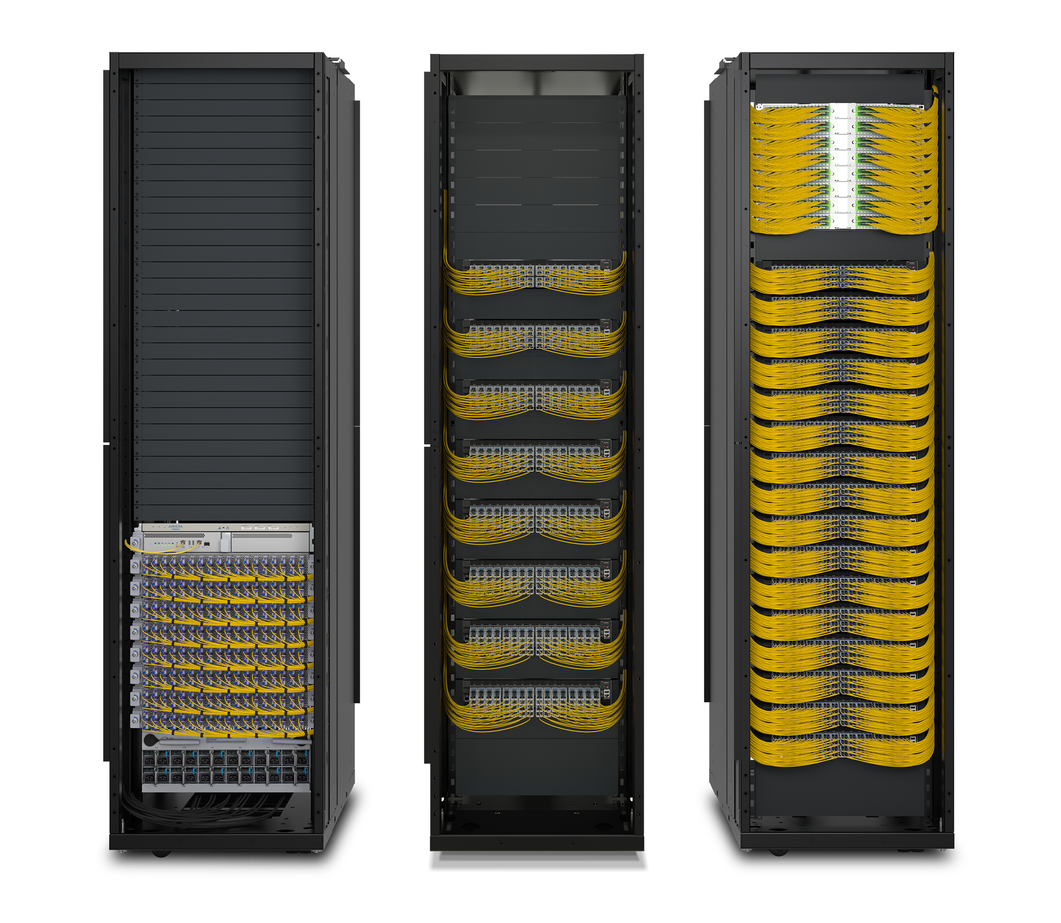
Why SDM4 MCF MSA?
Need: AI scale-out is creating major density constraints inside the datacenter
Speed: MSA to advance MCF ecosystem faster
  Standardization has started at international level (ITU-T, IEC, IEEE), but slow process
Scope: MSA encompasses 4-core MCF fiber requirements for passive connections in short-reach, O band applications (<2 km)
Timing: Targeted for release in coming months
Members: America Fujikura Ltd.; Corning Incorporated; Sumitomo Electric Industries, Ltd.; TeraHop PTE. LTD.
→ additional members welcomed after MSA release
CLOUD
32 GPU
AI NODE
72 GPU
AI NODE
Switch Rack Fiber Evolution
4

